Slide 1

1 Aladdin: Performance, Power, and Area Simulator
Peter H. Chen

Slide 2
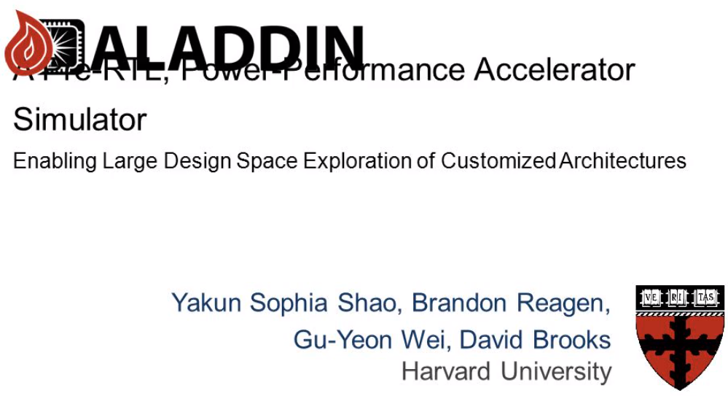
1 Aladdin: Performance, Power, and Area Simulator
https://slideplayer.com/slide/3222975/
Aladdin: Performance, Power, and Area Simulator

Slide 3
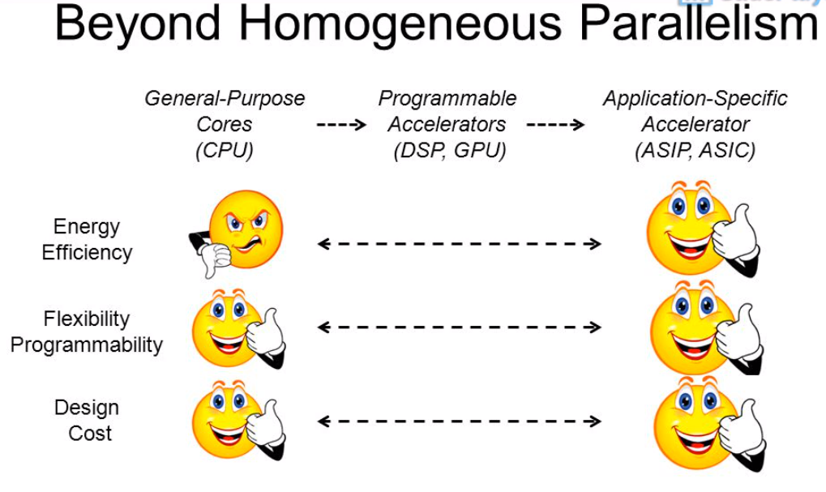
1 Aladdin: Performance, Power, and Area Simulator
https://slideplayer.com/slide/3222975/
Aladdin: Performance, Power, and Area Simulator

Slide 4
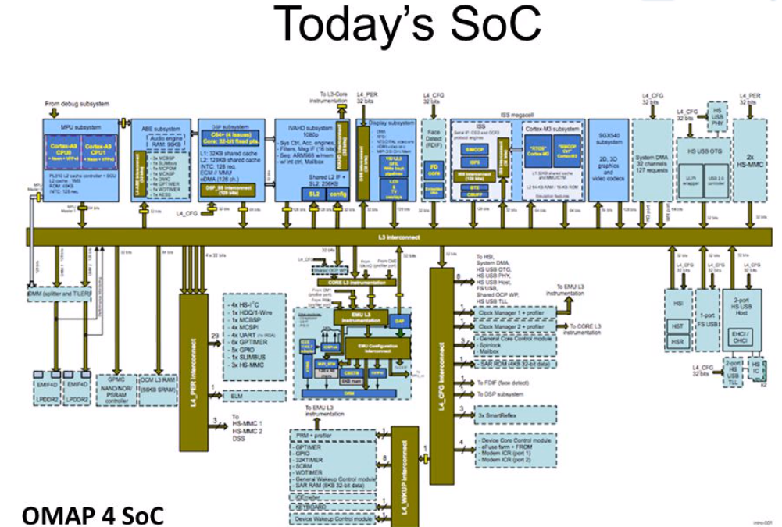
1 Aladdin: Performance, Power, and Area Simulator
https://slideplayer.com/slide/3222975/
Aladdin: Performance, Power, and Area Simulator

Slide 5
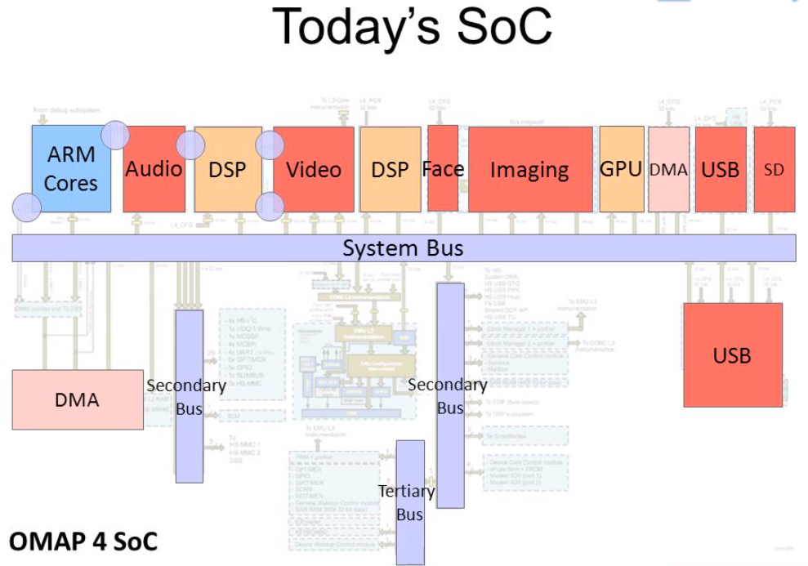
1 Aladdin: Performance, Power, and Area Simulator
https://slideplayer.com/slide/3222975/
Aladdin: Performance, Power, and Area Simulator

Slide 6
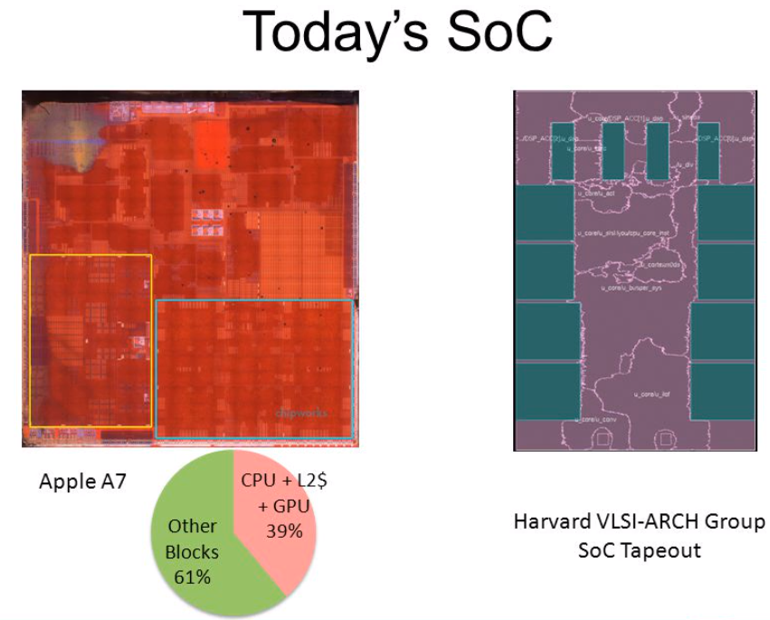
1 Aladdin: Performance, Power, and Area Simulator
https://slideplayer.com/slide/3222975/
Aladdin: Performance, Power, and Area Simulator

Slide 7
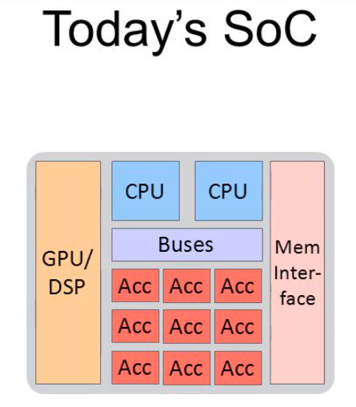
1 Aladdin: Performance, Power, and Area Simulator
https://slideplayer.com/slide/3222975/
Aladdin: Performance, Power, and Area Simulator
ACC: Accelerator
Hardware accelerator refers to the process by which an application will offload certain computing tasks onto specialized hardware components within the system, enabling greater efficiency than is possible in software running on a general-purpose CPU alone.

Slide 8
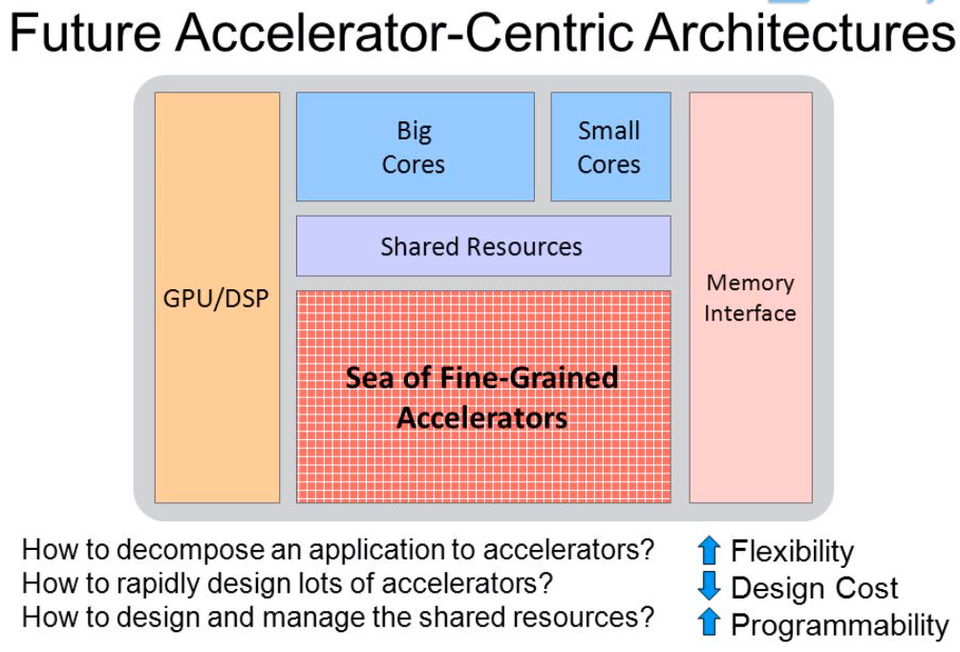
1 Aladdin: Performance, Power, and Area Simulator
https://slideplayer.com/slide/3222975/
Aladdin: Performance, Power, and Area Simulator

Slide 9
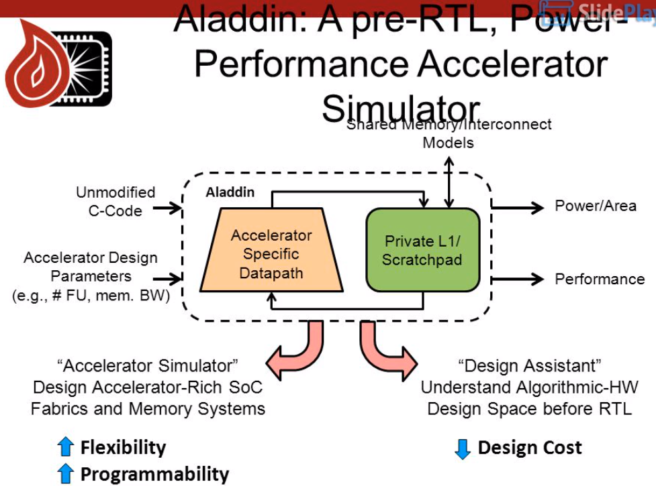
1 Aladdin: Performance, Power, and Area Simulator
https://slideplayer.com/slide/3222975/
Aladdin: Performance, Power, and Area Simulator
FU: Functional Unit
BW: Bit-Width

Slide 10
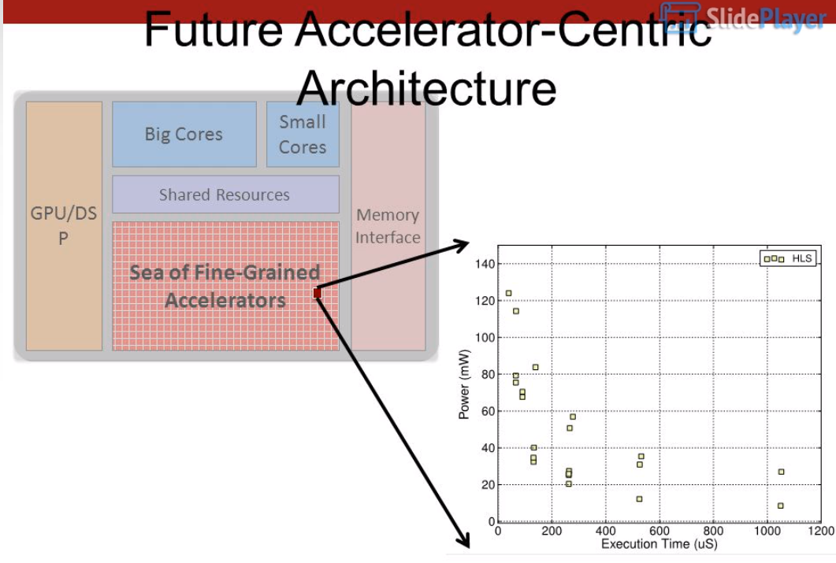
1 Aladdin: Performance, Power, and Area Simulator
https://slideplayer.com/slide/3222975/
Aladdin: Performance, Power, and Area Simulator

Slide 11
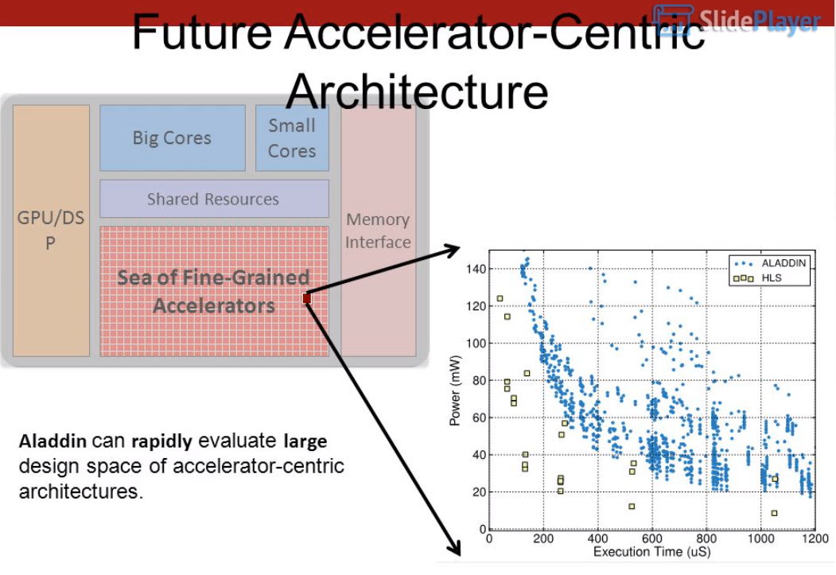
1 Aladdin: Performance, Power, and Area Simulator
https://slideplayer.com/slide/3222975/
Aladdin: Performance, Power, and Area Simulator

Slide 12
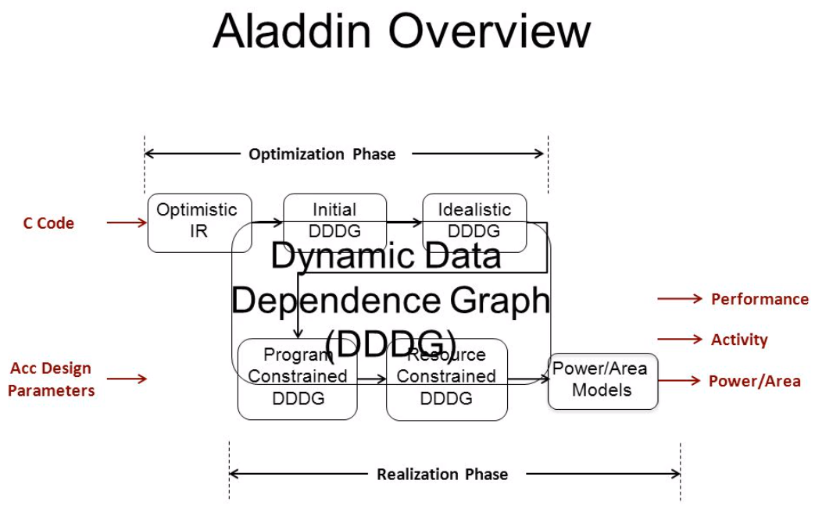
1 Aladdin: Performance, Power, and Area Simulator
https://slideplayer.com/slide/3222975/
Aladdin: Performance, Power, and Area Simulator
Optimization Phase
DDDG (Dynamic Data Dependence Graph)
IR (Independent Intermediate Representation)
Accelerator Design Parameters
Performance, Activity, Power, Area
Realization Phase

Slide 13
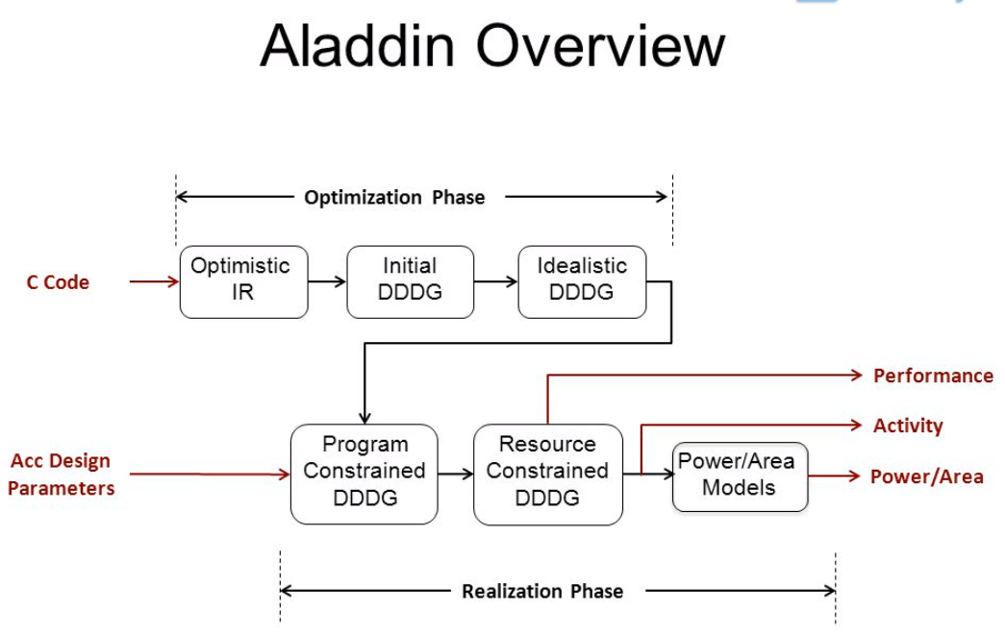
1 Aladdin: Performance, Power, and Area Simulator
https://slideplayer.com/slide/3222975/
Aladdin: Performance, Power, and Area Simulator
DDDG (Dynamic Data Dependence Graph)
IR (Independent Intermediate Representation)
Accelerator Design Parameters
Performance, Activity, Power, Area
Realization Phase

Slide 14
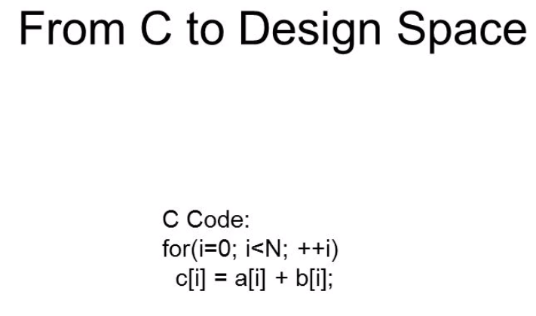
1 Aladdin: Performance, Power, and Area Simulator
https://slideplayer.com/slide/3222975/
Aladdin: Performance, Power, and Area Simulator

Slide 15
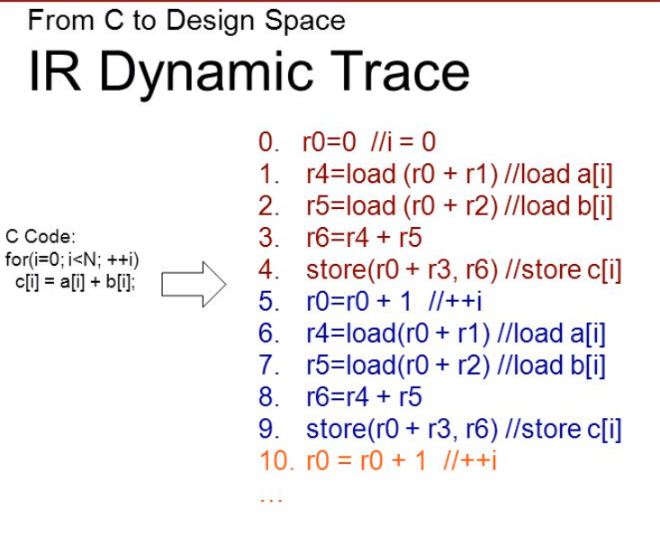
1 Aladdin: Performance, Power, and Area Simulator
https://slideplayer.com/slide/3222975/
Aladdin: Performance, Power, and Area Simulator
IR (Independent Intermediate Representation) Dynamic Trace

Slide 16
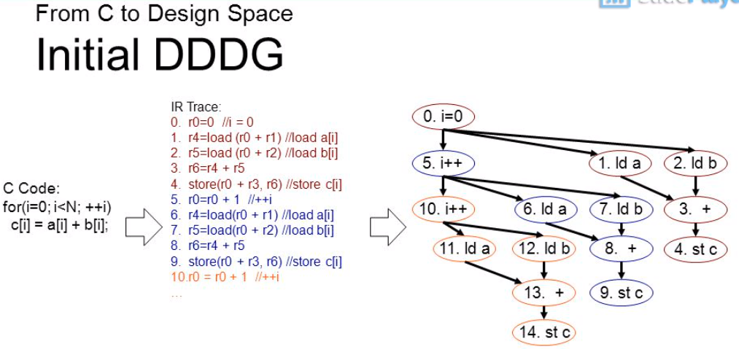
1 Aladdin: Performance, Power, and Area Simulator
https://slideplayer.com/slide/3222975/
Aladdin: Performance, Power, and Area Simulator
IR (Independent Intermediate Representation) Dynamic Trace
Initial DDDG (Dynamic Data Dependence Graph)

Slide 17
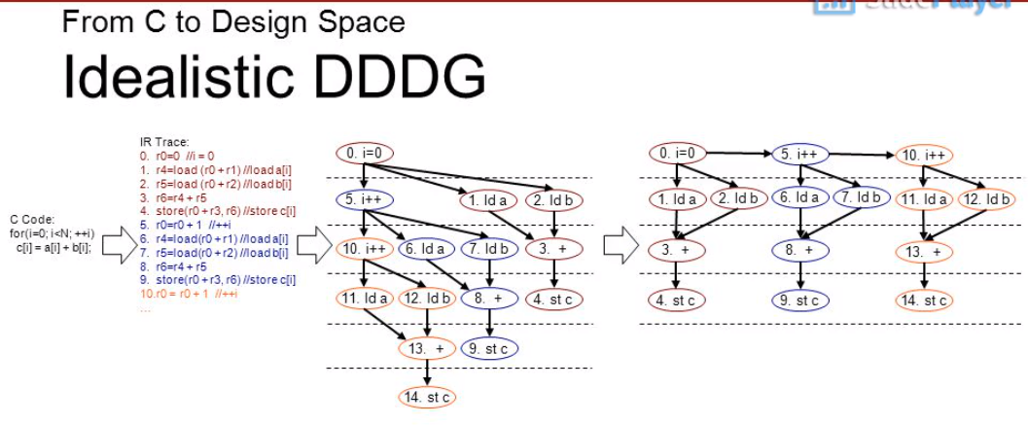
1 Aladdin: Performance, Power, and Area Simulator
https://slideplayer.com/slide/3222975/
Aladdin: Performance, Power, and Area Simulator
IR (Independent Intermediate Representation) Dynamic Trace
Initial DDDG (Dynamic Data Dependence Graph)
Idealistic DDDG (Dynamic Data Dependence Graph)

Slide 18
1 Aladdin: Performance, Power, and Area Simulator
https://slideplayer.com/slide/3222975/
Aladdin: Performance, Power, and Area Simulator
IR (Independent Intermediate Representation) Dynamic Trace
Initial DDDG (Dynamic Data Dependence Graph)
Idealistic DDDG (Dynamic Data Dependence Graph)

Slide 19
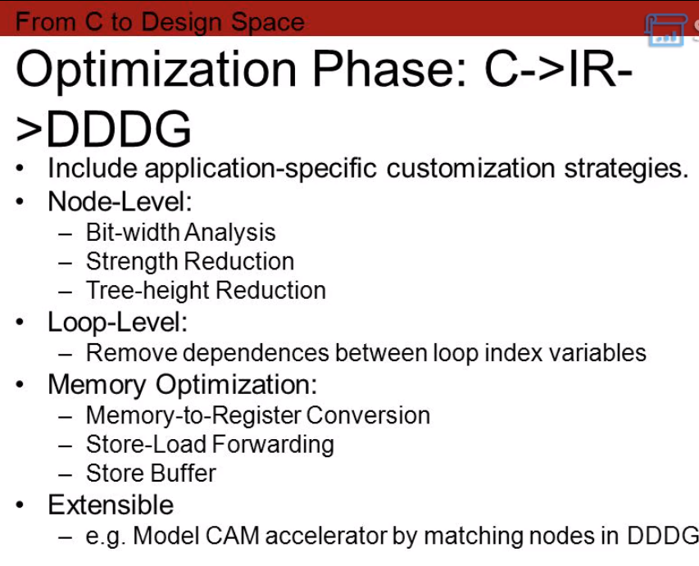
1 Aladdin: Performance, Power, and Area Simulator
https://slideplayer.com/slide/3222975/
Aladdin: Performance, Power, and Area Simulator
Optimization Phase:
From C
to IR (Independent Intermediate Representation) Dynamic Trace
to DDDG (DDDG (Dynamic Data Dependence Graph)
BW: Bit-Width
CAM (Content Address Memory) lookup for Memcached (Distributed Memory Object Caching System for Key-Value Store)

Slide 20
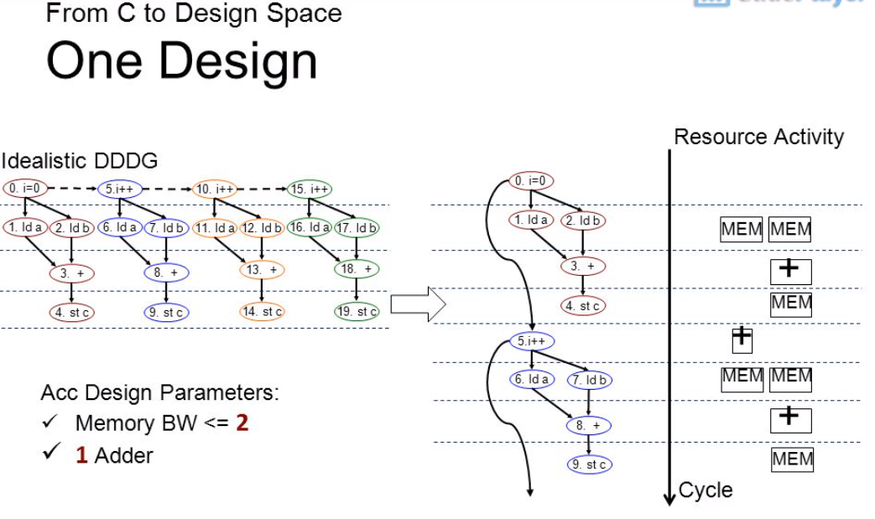
1 Aladdin: Performance, Power, and Area Simulator
https://slideplayer.com/slide/3222975/
Aladdin: Performance, Power, and Area Simulator
Idealistic DDDG (DDDG (Dynamic Data Dependence Graph)
Acc (Accelerator) Design Parameter
BW: Bit-Width

Slide 21
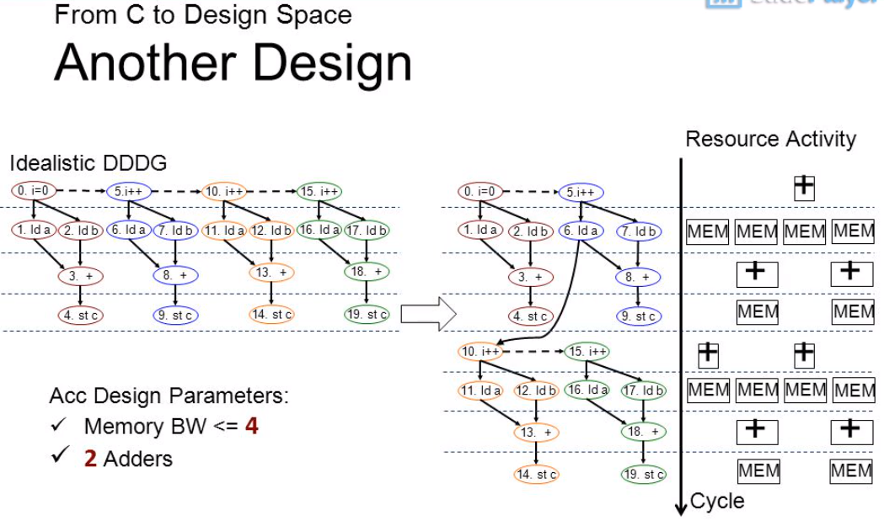
1 Aladdin: Performance, Power, and Area Simulator
https://slideplayer.com/slide/3222975/
Aladdin: Performance, Power, and Area Simulator
Same C code but with different design parameters
Idealistic DDDG (DDDG (Dynamic Data Dependence Graph)
Acc (Accelerator) Design Parameter
BW: Bit-Width

Slide 22
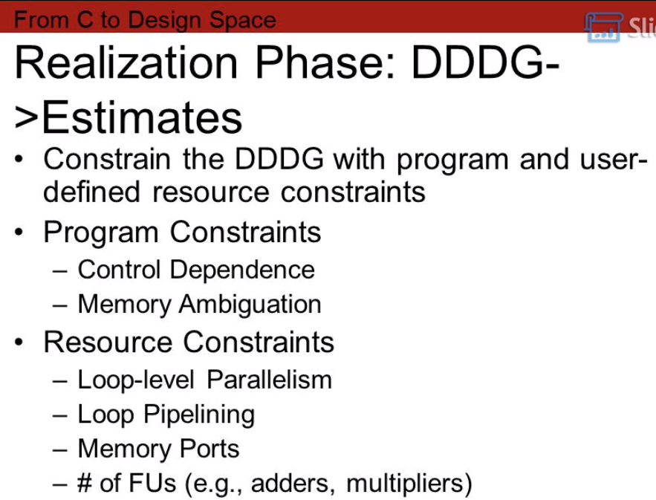
1 Aladdin: Performance, Power, and Area Simulator
https://slideplayer.com/slide/3222975/
Aladdin: Performance, Power, and Area Simulator
Realization Phase:
From Idealistic DDDG (DDDG (Dynamic Data Dependence Graph)
to Estimates
Constrain DDDG (DDDG (Dynamic Data Dependence Graph) with
Program Constraint and
User-defined Resource Constraints
1. Program Constraint
Control Dependence
Memory Ambiguation
2. User-Defined Resource Constraint
Loop-Level Parallelism
Loop Pipelining
Memory Ports
Number of FUs (Functional Units), for example, adder, multiplier

Slide 23
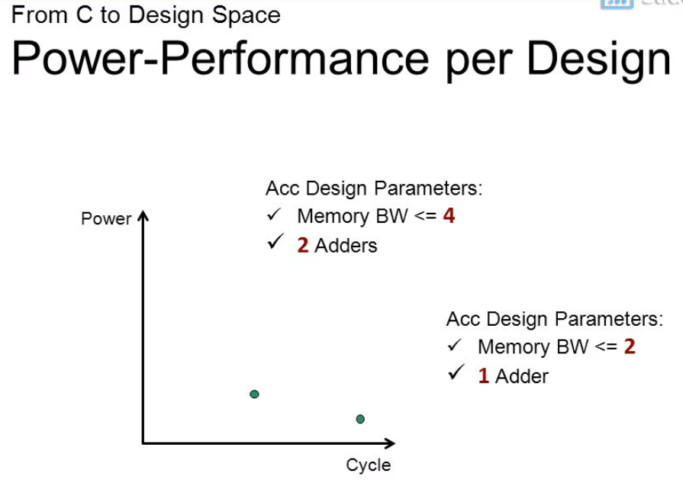
1 Aladdin: Performance, Power, and Area Simulator
https://slideplayer.com/slide/3222975/
Aladdin: Performance, Power, and Area Simulator
Acc (Accumulator) Design Parameters:
Memory BW (Bit-Width) <= 4
2 Adders
Acc (Accumulator) Design Parameters:
Memory BW (Bit-Width) <= 2
1 Adders

Slide 24
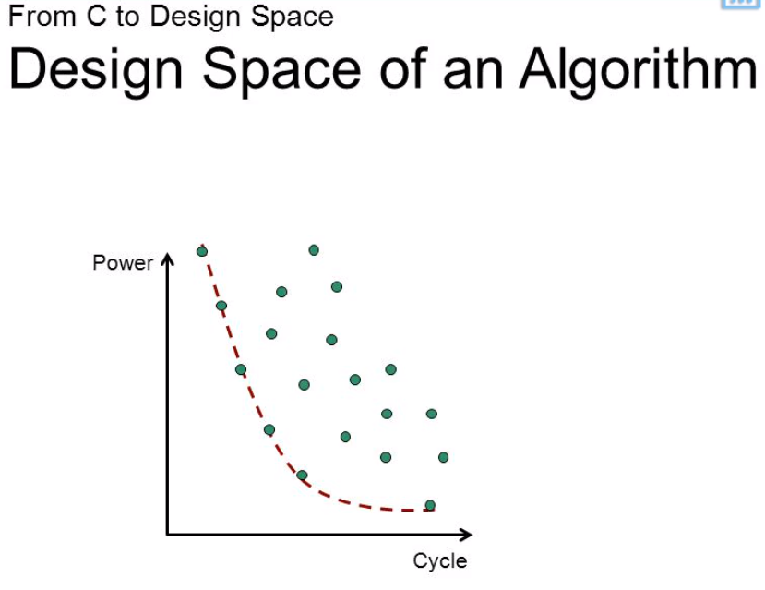
1 Aladdin: Performance, Power, and Area Simulator
https://slideplayer.com/slide/3222975/
Aladdin: Performance, Power, and Area Simulator
Acc (Accumulator) Design Parameters:
Memory BW (Bit-Width) <= 4
2 Adders
Acc (Accumulator) Design Parameters:
Memory BW (Bit-Width) <= 2
1 Adders
Cycle (Time)

Slide 25
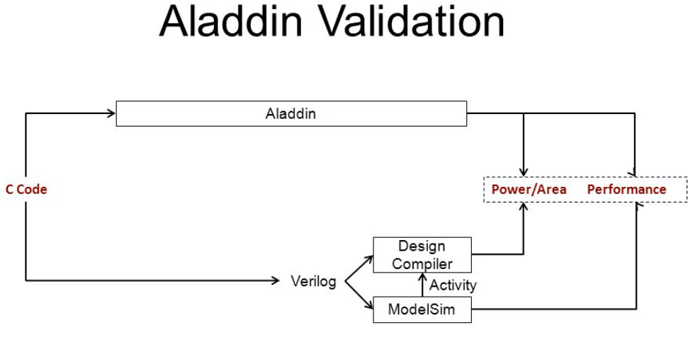
1 Aladdin: Performance, Power, and Area Simulator
https://slideplayer.com/slide/3222975/
Aladdin: Performance, Power, and Area Simulator
Aladdin’s performance model is validated against ModelSim Verilog simulations.
The SAIF activity file generated from ModelSim is fed to Design Compiler to capture the switching activity at the gate level.
To generate Verilog, we either hand-code RTL or use Xilinx’s Vivado HLS tool.
Aladdin Validation: Aladdin Simulator vs. RTL Flow Simulator
Aladdin Simulator
C Code
Performance, Power, Area
ModelSim Verilog Simulation
DC (Design Compiler)
ModelSim (from Mentor Graphics): Verification and Simulation for Verilog and mixed-language design.
Verilog
Activity
ModelSim

Slide 26
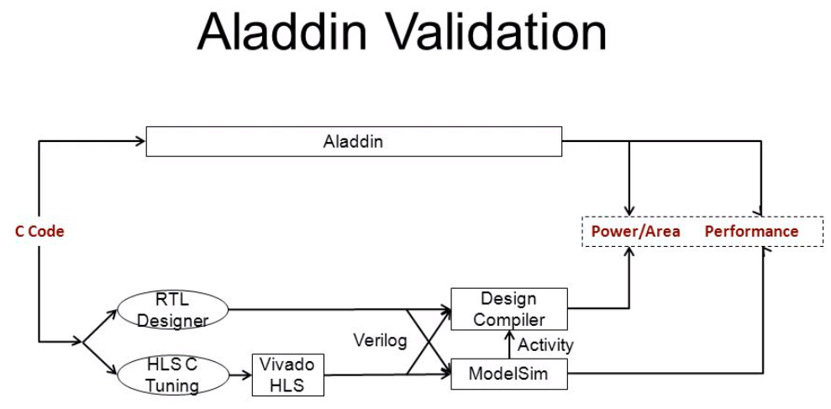
1 Aladdin: Performance, Power, and Area Simulator
https://slideplayer.com/slide/3222975/
Aladdin: Performance, Power, and Area Simulator
Aladdin’s performance model is validated against ModelSim Verilog simulations.
The SAIF activity file generated from ModelSim is fed to Design Compiler to capture the switching activity at the gate level.
To generate Verilog, we either hand-code RTL or use Xilinx’s Vivado HLS tool.
Aladdin Validation: Aladdin Simulator vs. RTL Flow Simulator
Aladdin Simulator
C Code
Performance, Power, Area
ModelSim Verilog Simulation
DC (Design Compiler)
RTL (Register Transfer Level): high level representation of a circuit
HLS (High Level Synthesis, C Synthesis, or Behavioral Synthesis): Translate behavioral into hardware circuits.
Vivado HLS (Xilinx Vivado Design Suite): Synthesis and analysis of HDL design
ModelSim (from Mentor Graphics): Verification and Simulation for Verilog and mixed-language design.

Slide 27
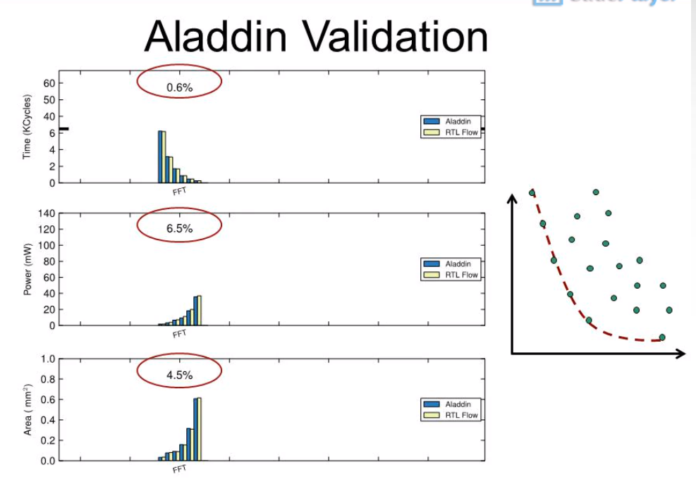
1 Aladdin: Performance, Power, and Area Simulator
https://slideplayer.com/slide/3222975/
Aladdin: Performance, Power, and Area Simulator
Aladdin Simulator vs. RTL Flow Simulator
Performance: Aladdin vs. RTL Flow Deviation (0.6%)
Power
Power: Aladdin vs. RTL Flow Deviation (6.5%)
Area: Aladdin vs. RTL Flow Deviation (4.5%)
Cycle (Time)

Slide 28
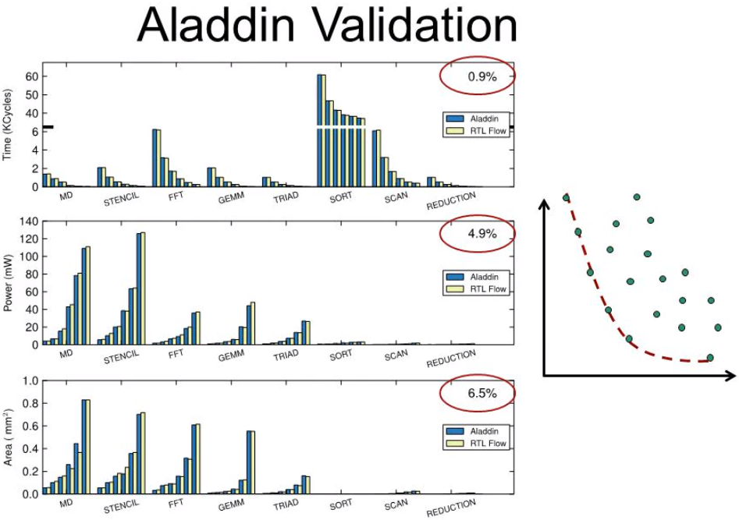
1 Aladdin: Performance, Power, and Area Simulator
https://slideplayer.com/slide/3222975/
Aladdin: Performance, Power, and Area Simulator
Aladdin Simulator vs. RTL Flow Simulator
Design Performance: Aladdin vs. RTL Flow Deviation (0.9%)
Power
Design Power: Aladdin vs. RTL Flow Deviation (4.9%)
Design Area: Aladdin vs. RTL Flow Deviation (6.5%)
Cycle (Time)

Slide 29
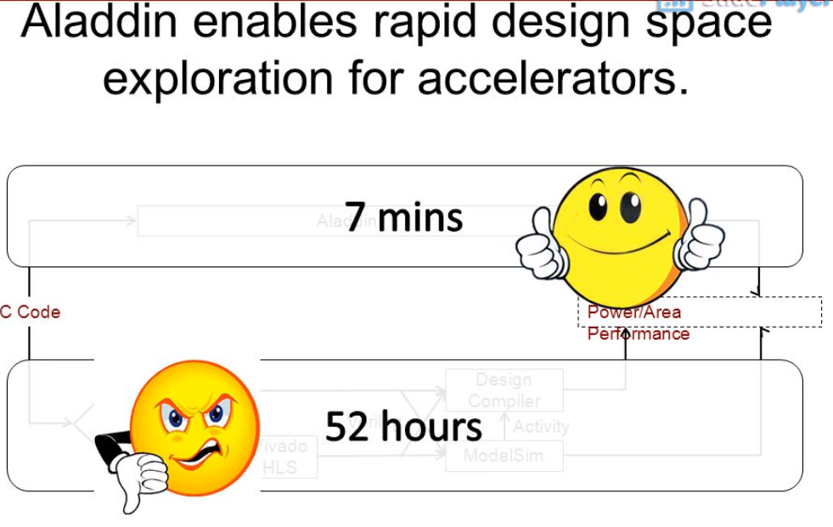
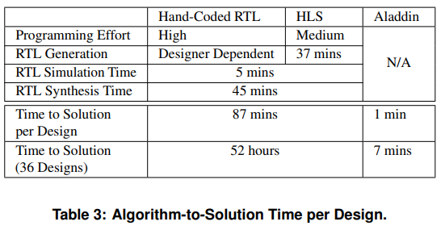
1 Aladdin: Performance, Power, and Area Simulator
https://slideplayer.com/slide/3222975/
Aladdin: Performance, Power, and Area Simulator
For accelerator, Aladdin cut simulation time from 52 hours to 7 mins.
Aladdin Simulator
RTL Flow Simulator

Slide 30
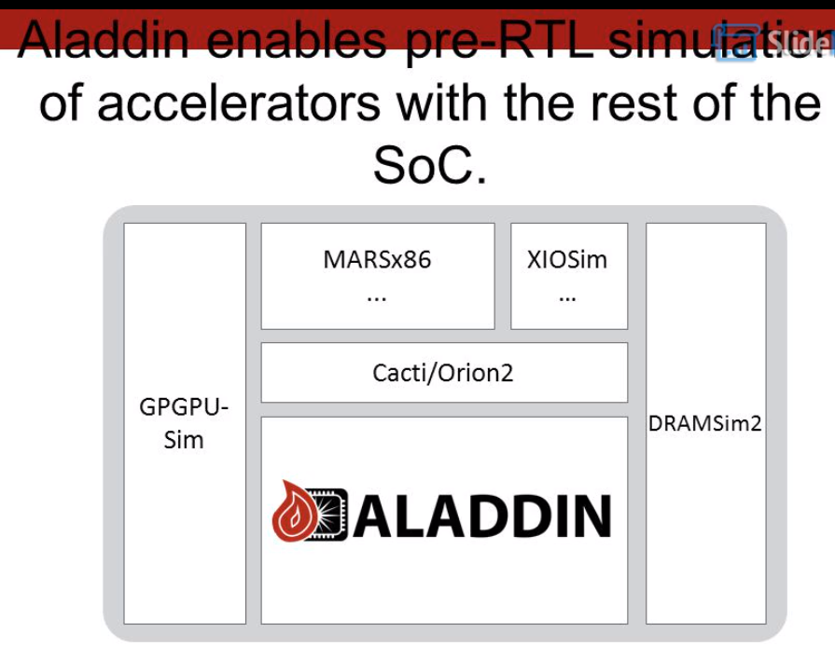
1 Aladdin: Performance, Power, and Area Simulator
https://slideplayer.com/slide/3222975/
Aladdin: Performance, Power, and Area Simulator
Big Cores: MARSx86, …
Small Cores: XIOSim, …
Share Buses: Cacti/ORion2
Memory Interface:
DRAMSim2
GPGPU (General Purpose Graphic Processing Unit): GPGPUSim
Fine-Grains Accelerators:
Aladdin pre-RTL Simulator

Slide 31
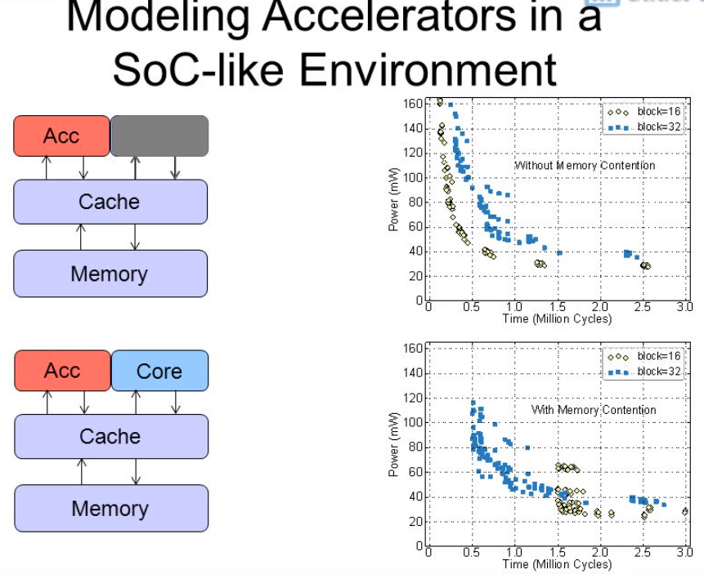
1 Aladdin: Performance, Power, and Area Simulator
https://slideplayer.com/slide/3222975/
Aladdin: Performance, Power, and Area Simulator
Without memory confliction
With memory confliction

Slide 32
End

